Slide 1
Stage 4 You Spin Me Right Round Course Designer: Marcel Englmaier
You Spin Me Right Round is at least a 14 round unlimited course. There are 2 square plates, 2 diamond plates, and a spinner. The square plates require 4 hits, the round plates 2 hits, and the spinner must be spun twice. The start signal is audible.
The Handgun start position is standing in middle box and wrists below belt. Handgun loaded and holstered. If you do not have a holster, the pistol will be loaded and placed on barrel 1. The PCC start position is standing in middle box. PCC loaded, safety on, stock touching belt.
On the audible start signal, engage targets in the following order: First, spin the spinner from the middle box. Then engage the left square with at least 2 shots and the left round with at least 1 shot from the left box and the right square with at least 2 shots and the right round with at least 1 shot from the right box. Then spin the spinner again from the middle box. Finally, re-engage the left square with at least 2 shots and the left round with at least 1 shot from the left box and the right square with at least 2 shots and the right round with at least 1 shot from the right box. Failure to spin the spinner will incur 10 misses per occurrence. The Spinner is the first target in the tablet worth 20 Alphas.

Slide 2
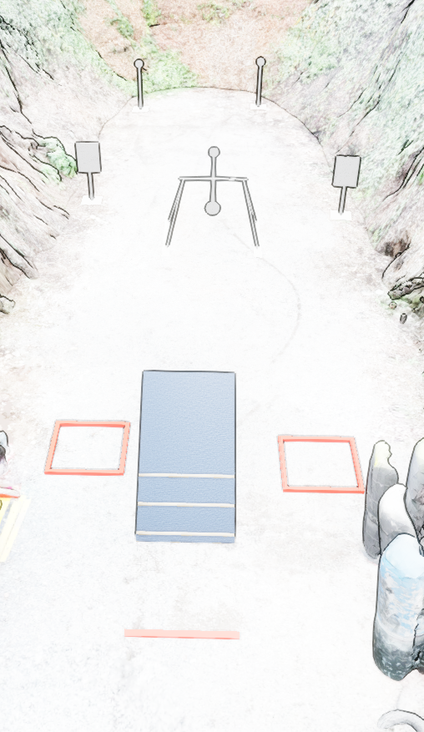

 | Stage 3, Bay 4 You Spin Me Right Round Course Designer: Marcel Englmaier

